Slide 1

LPP SA Financial Results
I-IIIQ 2014
Warsaw, November 7th, 2014

Slide 2
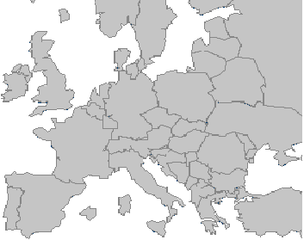


Our brands present across CEE region
As of September 30th, LPP’s retail network included 1453 stores:
413 Reserved
357 CROPP
301 House
246 Mohito
113 Sinsay
7
5
3
5
5
1
77
8
67
3
8
2
45
7
3
55
5
234
2
13
217
207
outlet
4
1
151
outlet
19
23
89
10
20
19
12
15
18
11
11
13
4
17
1
1
1
5
2
9
2
1
1
4
3
3
3

Slide 3
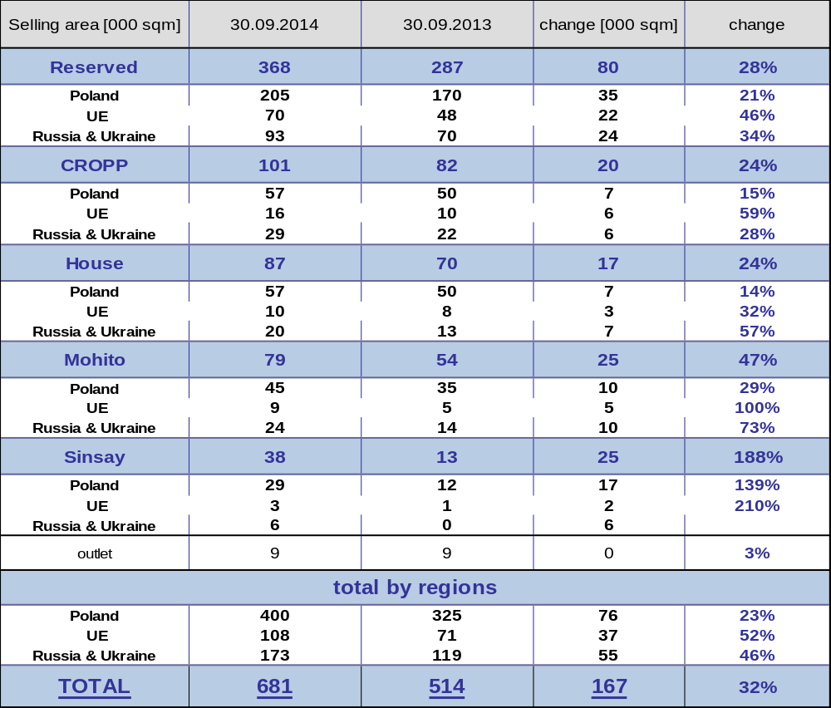
Retail selling area growth
3
Notes:
3

Slide 4
Retail sale revenue split by brands

Slide 5
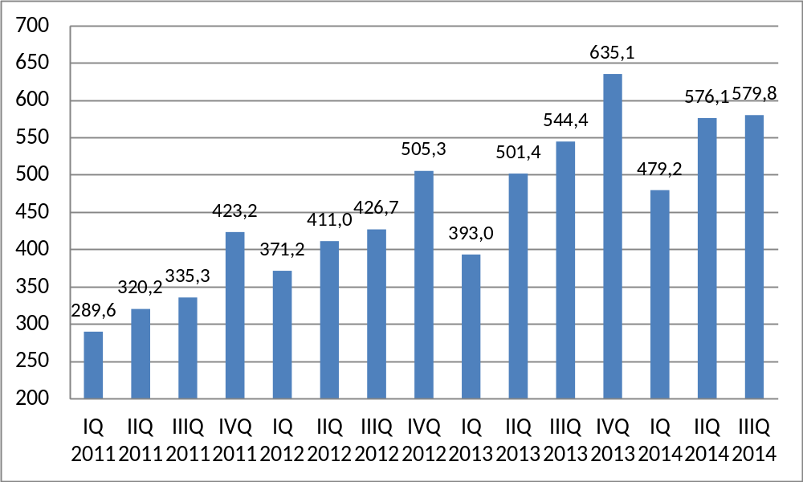
Retail sale revenue of RESERVED brand [PLN mln]

Slide 6
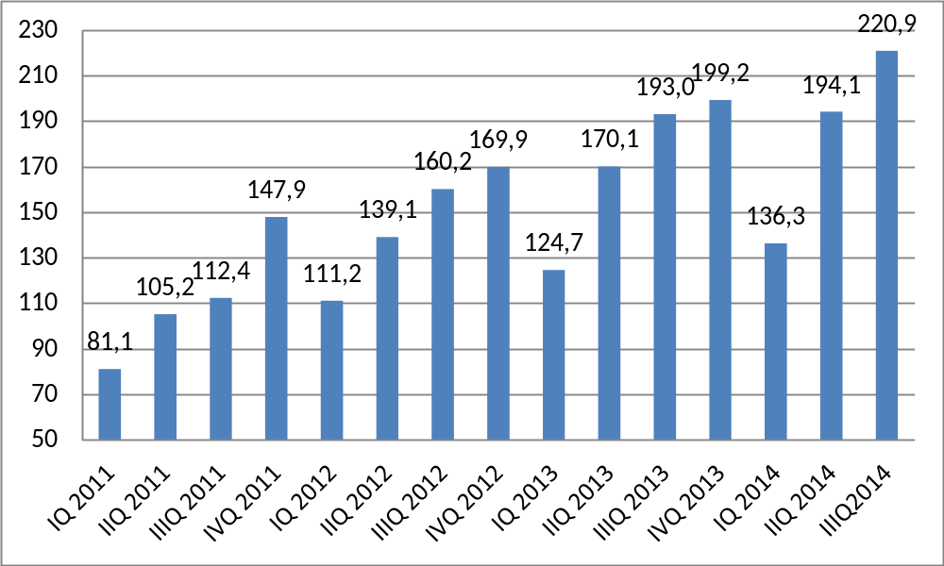
Retail sale revenue of CROPP brand [PLN mln]

Slide 7
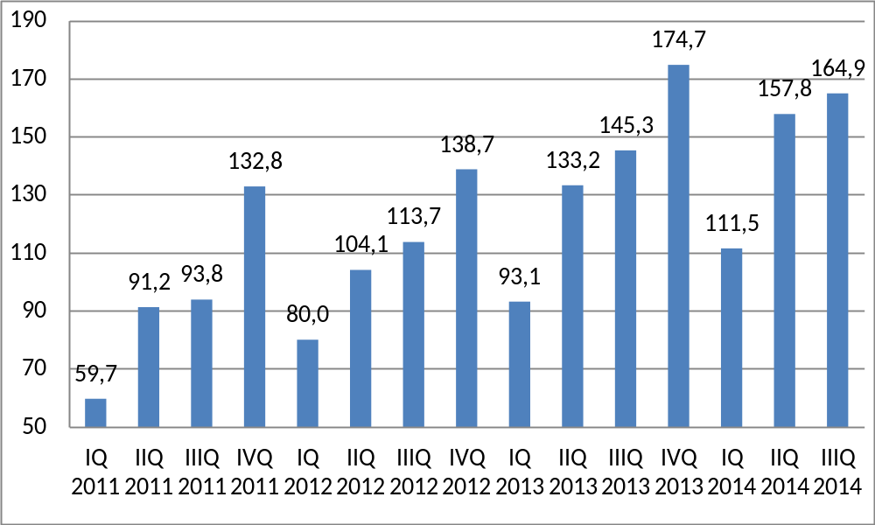
Retail sale revenue of HOUSE brand [PLN mln]
7
Notes:
7

Slide 8
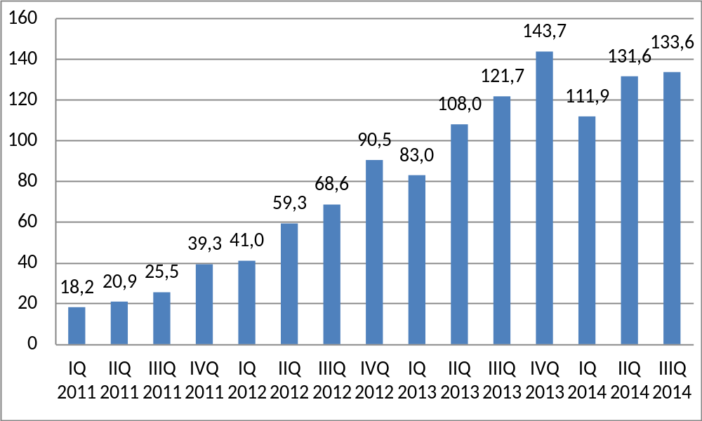
Retail sale revenue of MOHITO brand [PLN mln]
8
Notes:
8

Slide 9
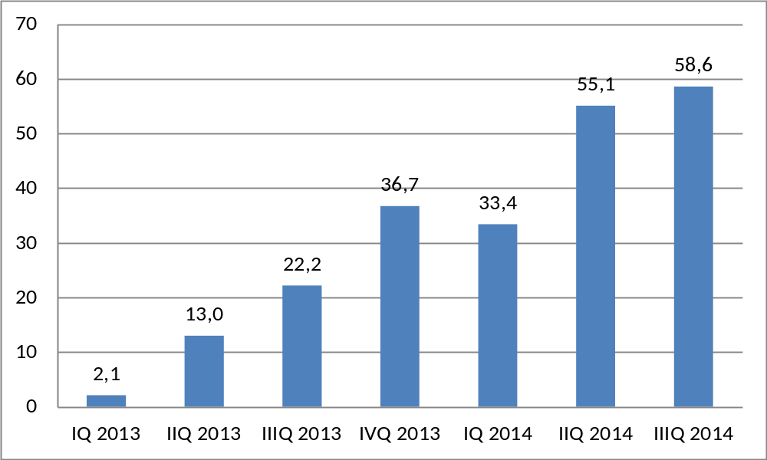
Retail sale revenue of SINSAY brand [PLN mln]
9
Notes:
9

Slide 10
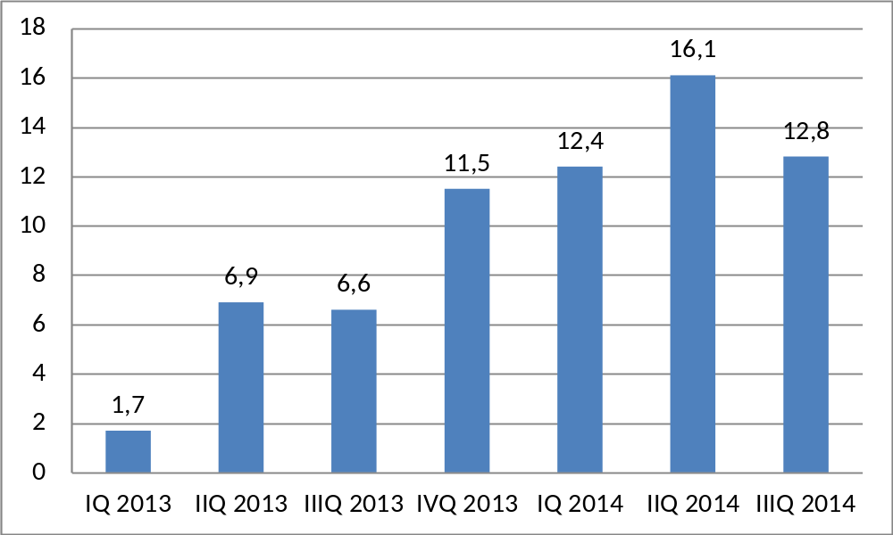
Retail sale revenue of e-commerce [PLN mln]
10
Notes:
10

Slide 11
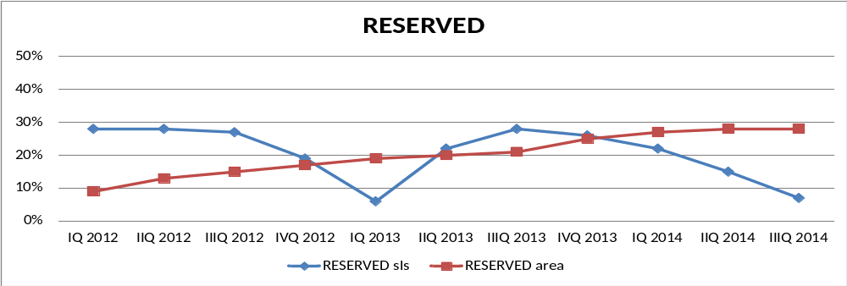
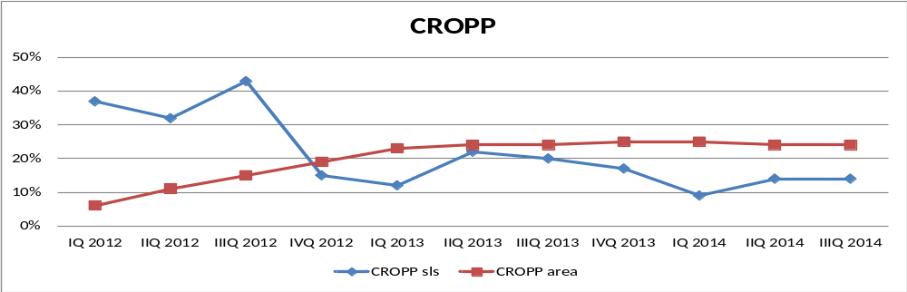
Change of Efficiency

Slide 12
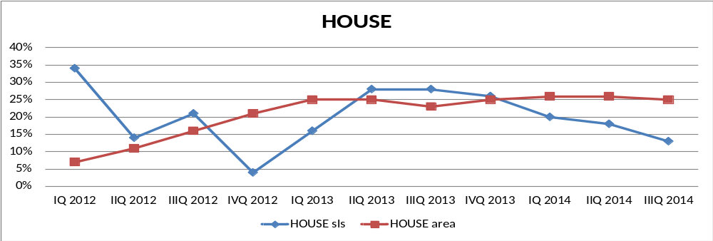
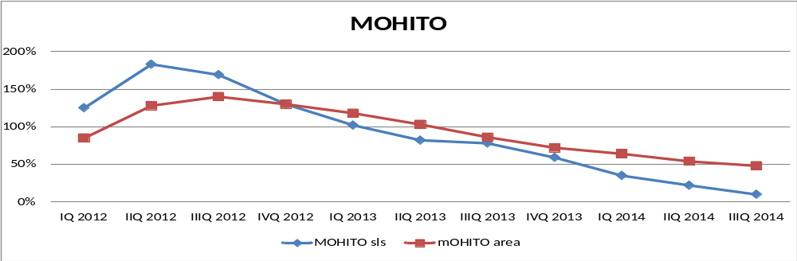
Change of Efficiency
12
Notes:
12

Slide 13
Gross Margin on Sales (%)

Slide 14

SG&A Costs per sqm in PLN (Total costs/Total selling space in sqm/Month)
14
Notes:
14

Slide 15
Costs in own stores (Rent / Personnel / Other) in PLN/sqm/month
15
Notes:
15

Slide 16
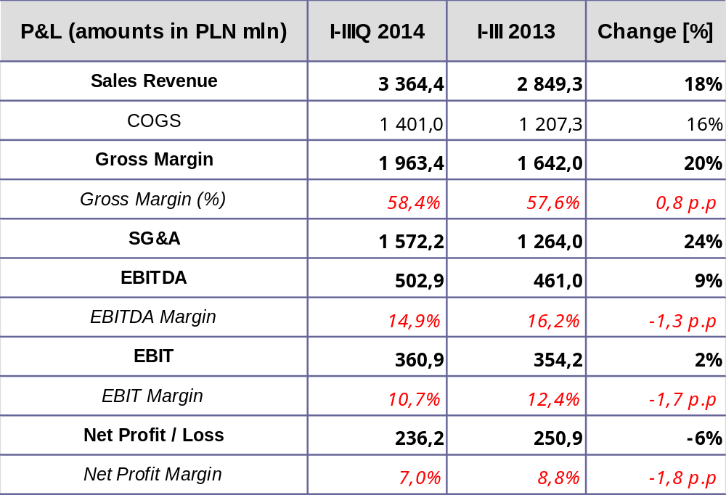
Consolidated Profit & Loss Account I-IIIQ 2014
16
Notes:
16

Slide 17
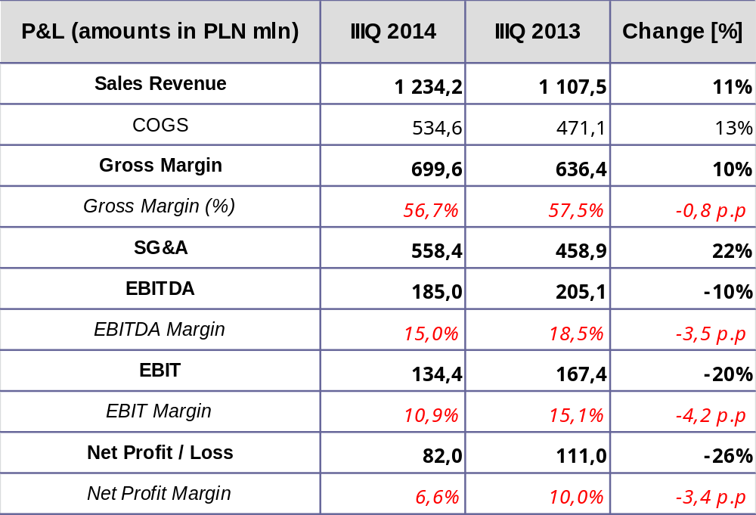
Consolidated Profit & Loss Account IIIQ 2014
17
Notes:
17

Slide 18
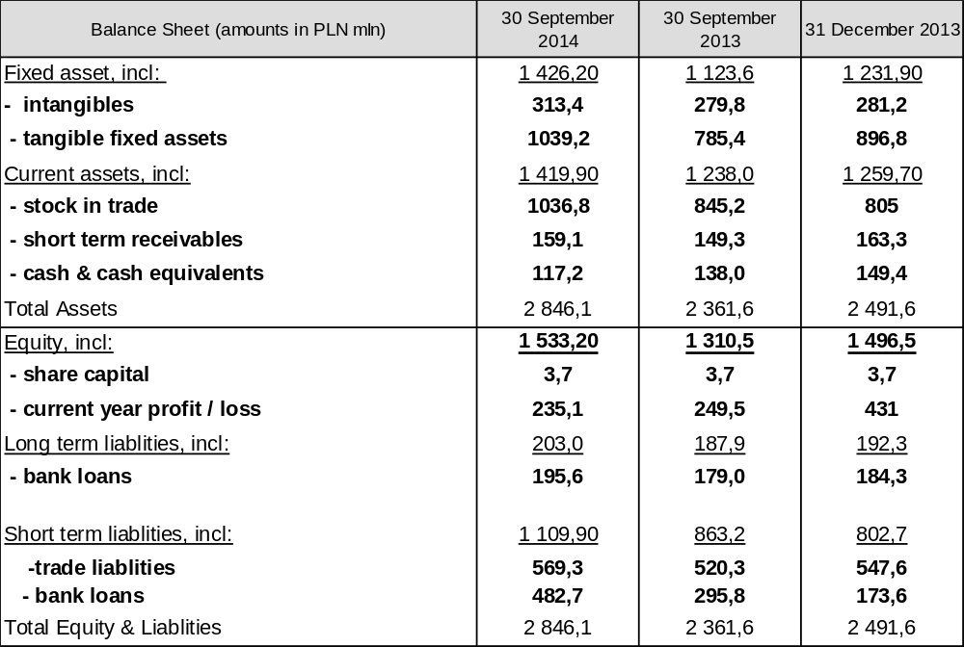
Consolidated Balance Sheet

Slide 19
Other Operating Income and Costs for I-IIIQ [PLN mln]
Operating Costs I-IIIQ
Total 57,4
Impairments 13,8
Inventory Losses 30,2
Donations and write-offs 8,2
Operating Income I-IIIQ
Total 27,0
Compensation for inv. losses 9,1
Profit on assets sale 11,4
19
Notes:
19

Slide 20
Other Financial Income and Costs for I-IIIQ [PLN mln]
Financial Costs I-IIIQ
Total 76,6
FX Losses 62,9
Interests paid 11,0
Commisions and Fees 2,6
Financial Income I-IIIQ Total 2,0
Interests income 1,8
Other 0,2

Slide 21
Other Operating Income and Costs for IIIQ [PLN mln]
Operating Costs IIIQ
Total 14,3
Impairments 1,6
Inventory Losses 8,5
Donations and write-offs 1,6
Operating Income IIIQ
Total 7,5
Compensation for inv. losses 3,3
Profit on assets sale 1,9
21
Notes:
21

Slide 22
Other Financial Income and Costs for IIIQ [PLN mln]
Financial Costs IIIQ
Total 39,6
FX Losses 35,5
Interests paid 3,6
Commisions and Fees 0,5
Financial Income IIIQ Total 0,4
Interests income 0,4

Slide 23
Stock in trade
23
Notes:
23

Slide 24
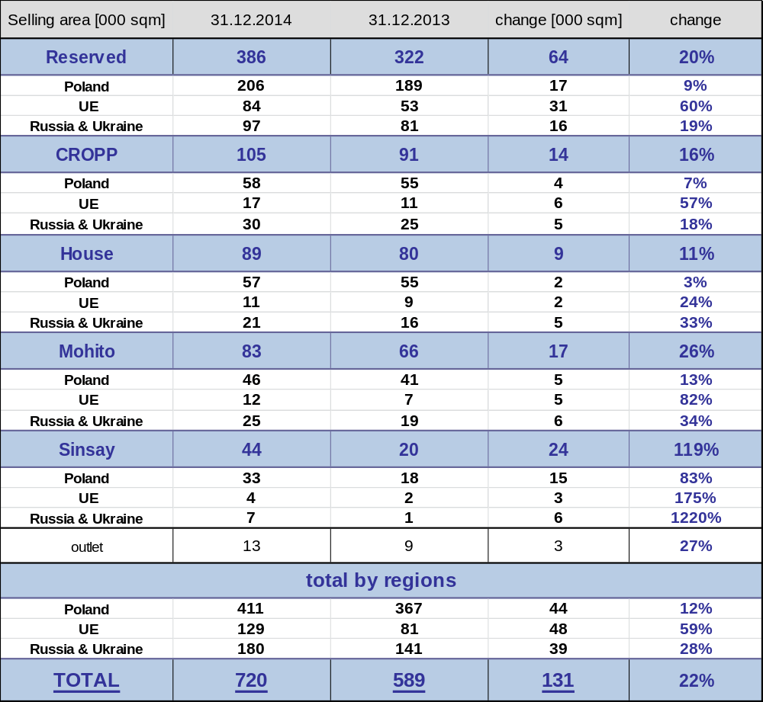
Selling Area Growth

Slide 25
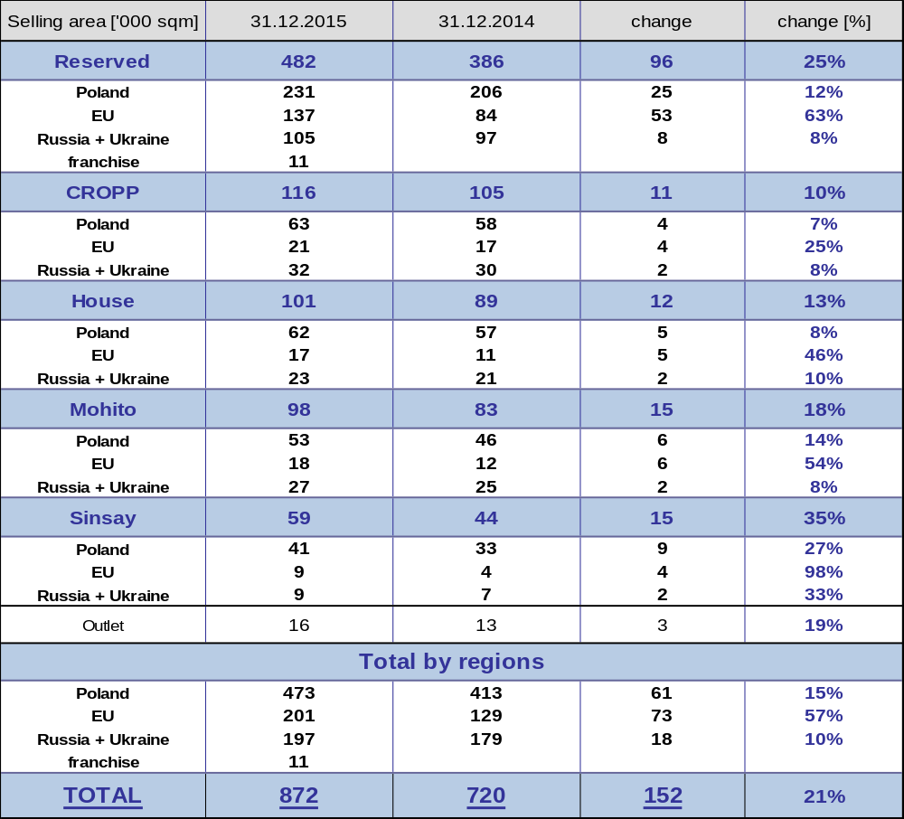
Selling area growth in 2015 - possibilities
Selling area growth presented for 2015 is not the final forecast, however it is in line with current projects.
The final plan for 2015 will be presented at the 4Q2014 results conference..

Slide 26

Thank you for your attention

